Slide 1


Module 4:
Selenium WebDriver
Selenium WD JS Advanced

Slide 2
Agenda
1
Actions.
2
Javascript executor.
3
Selenium Grid.

Slide 3
PART 1
Actions

Slide 4

ACTIONS
The user-facing API for emulating complex user gestures
(interactions with a keyboard and mouse)
click
doubleClick
dragAndDrop
keyDown
keyUp
mouseDown
mouseMove
mouseUp
perform
sendKeys

Slide 5
ACTIONS
Common way to run a chain:
driver.actions().{method1>…<methodN>}.perform();
perform() – routine for executing chain - each sequence will not be executed until perform() is called.

Slide 6
ACTIONS. CLICK.
click(opt_elementOrButton, opt_button) - clicks a mouse button (at the current cursor location).
If an element is provided, the mouse will first be moved to the center of that element. This is equivalent to:
sequence.mouseMove(element).click()
Parameters:
opt_elementOrButton (WebElement|Button|null|undefined)
Either the element to interact with or the button to click with. Defaults to input.Button.LEFT if neither an element nor button is specified.
opt_button (Button|null|undefined)
The button to use. Defaults to input.Button.LEFT. Ignored if a button is provided as the first argument.

Slide 7
ACTIONS. DOUBLECLICK.
doubleClick(opt_elementOrButton, opt_button) - double-clicks a mouse button (at the current cursor location).
If an element is provided, the mouse will first be moved to the center of that element. This is equivalent to:
sequence.mouseMove(element).doubleClick()
Parameters:
opt_elementOrButton (WebElement|Button|null|undefined)
Either the element to interact with or the button to click with. Defaults to input.Button.LEFT if neither an element nor button is specified.
opt_button (Button|null|undefined)
The button to use. Defaults to input.Button.LEFT. Ignored if a button is provided as the first argument.
Warning: this method currently only supports the left mouse button.

Slide 8
ACTIONS. EXAMPLES.
//Click current position
driver.actions().click().perform();
driver.actions().doubleClick().perform();
//Click web element
driver.actions().click(el).perform();
driver.actions().doubleClick(el).perform();

Slide 9
ACTIONS. DRAG AND DROP.
dragAndDrop(element, location) - convenience function for performing a "drag and drop" manuever.
The target element may be moved to the location of another element, or by an offset (in pixels).
Parameters:
element WebElement
The element to drag.
location (WebElement|{x: number, y: number})
The location to drag to, either as another WebElement or an offset in pixels.
Examples:
driver.actions().dragAndDrop(el, {x: -120, y: 0}).perform();
driver.actions().dragAndDrop(el1, el2).perform();

Slide 10
ACTIONS. KEY DOWN. KEY UP.
keyDown(key) - performs a modifier key press. The modifier key is not released until keyUp or sendKeys is called.
The key press will be targeted at the currently focused element.
Parameters:
Key
The modifier key to push. Must be one of {ALT, CONTROL, SHIFT, COMMAND, META}.
keyUp(key) - performs a modifier key release. The release is targeted at the currently focused element.
Parameters:
Key
The modifier key to release. Must be one of {ALT, CONTROL, SHIFT, COMMAND, META}.
Examples:
driver.actions().keyDown(Key.SHIFT).click(element1).click(element2).dragAndDrop(element3, element4).keyUp(Key.SHIFT).perform();

Slide 11
ACTIONS. MOUSE DOWN.
mouseDown(opt_elementOrButton, opt_button) - presses a mouse button.
The mouse button will not be released until mouseUp is called, regardless of whether that call is made
in this sequence or another.
If an element is provided, the mouse will first be moved to the center of that element. This is equivalent to:
sequence.mouseMove(element).mouseDown()
Parameters:
opt_elementOrButton (WebElement|Button|null|undefined)
Either the element to interact with or the button to click with. Defaults to input.Button.LEFT if neither an element nor button is specified.
opt_button (Button|null|undefined)
The button to use. Defaults to input.Button.LEFT. Ignored if a button is provided as the first argument.

Slide 12
ACTIONS. MOUSE MOVE.
mouseMove(location, opt_offset) - Moves the mouse. The location to move to may be specified
in terms of the mouse's current location, an offset relative to the top-left corner of an element,
or an element (in which case the middle of the element is used).
Parameters:
location (WebElement|{x: number, y: number})
The location to drag to, as either another WebElement or an offset in pixels.
opt_offset ({x: number, y: number}|undefined)
If the target location is defined as a ./webdriver.WebElement, this parameter defines an offset within that element. The offset should be specified in pixels relative to the top-left corner of the element's bounding box. If omitted, the element's center will be used as the target offset.

Slide 13
ACTIONS. MOUSE UP.
mouseUp(opt_elementOrButton, opt_button) - releases a mouse button. Behavior is undefined for
calling this function without a previous call to mouseDown.
If an element is provided, the mouse will first be moved to the center of that element. This is equivalent to:
sequence.mouseMove(element).mouseUp()
Parameters:
opt_elementOrButton (WebElement|Button|null|undefined)
Either the element to interact with or the button to click with. Defaults to input.Button.LEFT if neither an element nor button is specified.
opt_button (Button|null|undefined)
The button to use. Defaults to input.Button.LEFT. Ignored if a button is provided as the first argument.

Slide 14
ACTIONS. MOUSE. EXAMPLES.
driver.actions().mouseMove(el).perform();
driver.actions().mouseDown().mouseMove(element1,{x:170,y:170}).mouseUp().perform();
driver.actions().mouseMove(elem).mouseDown().mouseUp().perform();
driver.actions().mouseMove(element).mouseMove({x: 50, y: 0}).doubleClick().perform();

Slide 15
ACTIONS. SEND KEYS.
sendKeys( ...var_args ) - simulates typing multiple keys. Each modifier key encountered in the sequence will not be released until it is encountered again. All key events will be targeted at the currently focused element.
Parameters:
var_args ...(string|Key|Array<(string|Key)>)
The keys to type.
Examples:
driver().sendKeys(Key.ARROW_RIGHT).perform();
driver.actions().sendKeys(Key.ENTER).perform();

Slide 16
DEMO

Slide 17
PART 2
Javascript executor

Slide 18
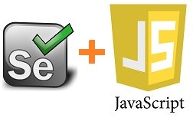
JAVASCRIPT EXECUTOR
JavaScript Executor is an interface, that provides mechanism to execute JavaScript through WebDriver.
Basically javascript executor "executes javascript within the browser".
There are two methods available to execute javascript.
browser.executeScript – Usually we use executeScript to run normal javascript or JQuery code within the browser
browser.executeAsyncScript – We use executeAsyncScript to execute ajax calls or any javascript code with callback functions.

Slide 19
JAVASCRIPT EXECUTOR. CLICK
1. Pass element to javascript code and click on it:
driver.findElement(webDriver.By.linkText("features"));
driver.executeScript("arguments[0].click()", el);
2. Use document.getElementById/querySelector/querySelectorAll to identify an element and .click() to simulate click operation.
var selector = "#npm-logo a"; return driver.executeScript("document.querySelector('" + selector+ "').click()");

Slide 20
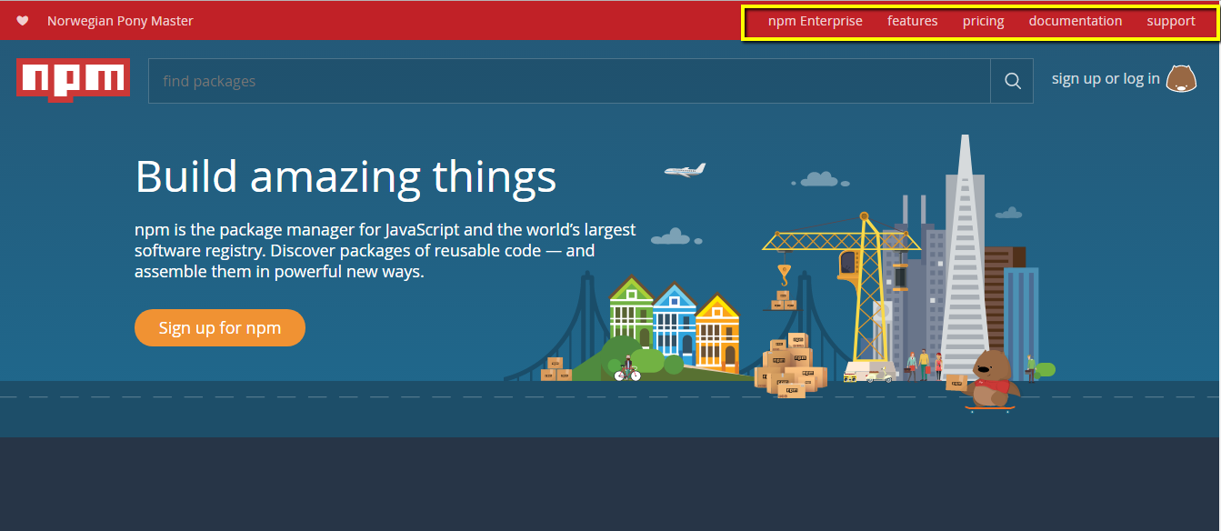
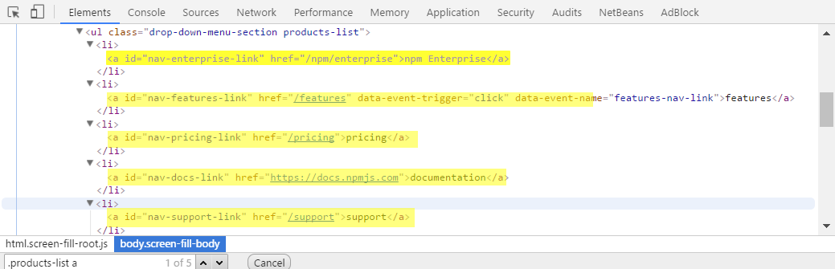
JAVASCRIPT EXECUTOR. RETURN COLLECTION OF WEBELEMENTS
driver.get('https://www.npmjs.com/').then(function () { return driver.executeScript("var elements = document.querySelectorAll('.products-list a'); return elements;"); }).then(function (tabs) { console.log('Number of links: ', tabs.length); }).then(function () { driver.quit(); });

Slide 21
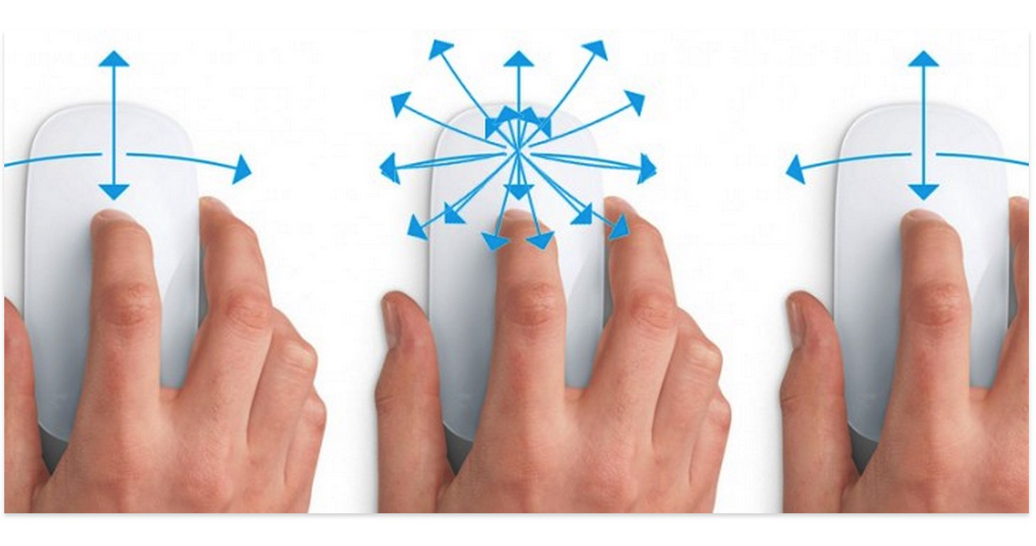
JAVASCRIPT EXECUTOR. SCROLL
// scroll into view return driver.executeScript("arguments[0].scrollIntoView();", el);
// scroll to top return driver.executeScript('window.scrollTo(0, 0)');
// scroll to the end of the page return driver.executeScript('window.scrollTo(0, document.body.scrollHeight)');
// scroll by coordinates return driver.executeScript('window.scrollTo(300, 100)');

Slide 22
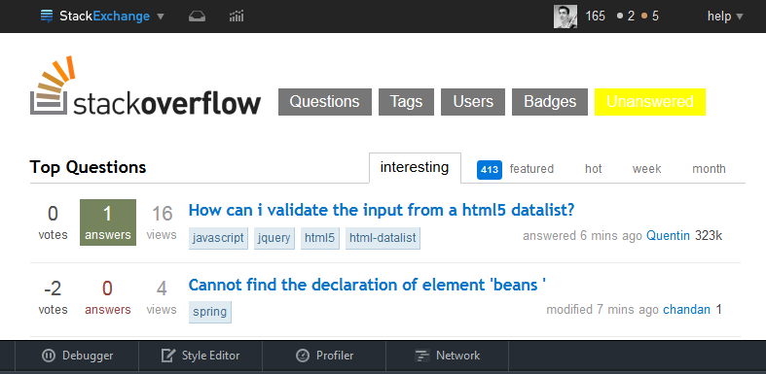
JAVASCRIPT EXECUTOR. HIGHLIGHTING
JavaScript Script:
document.getElementById('nav-askquestion').style.backgroundColor = "yellow"
var el = driver.findElement(By.name('q'));
driver.executeScript("arguments[0].style.backgroundColor = '" + "red" + "'", el)

Slide 23
JAVASCRIPT EXECUTOR. USE CASES
1) Refresh browser window using Javascript
driver.executeScript("history.go(0)");
2) Get the title of our webpage
driver.executeScript("return document.title;")
3) Click on a SubMenu which is only visible on mouse hover on Menu.
driver.executeScript("$('ul.menus.menu-secondary.sf-js-enabled.sub-menu li').hover()");
4) Get the URL of a webpage
driver.executeScript("return document.URL;")
5) Select text, remember selected text and etc.

Slide 24
DEMO

Slide 25
PART 3
Selenium Grid

Slide 26
SELENIUM GRID
Capabilities
Selenium Grid
Selenium Tests
Selenium Hub
Application Under Test
Browser
Browser
Browser

Slide 27
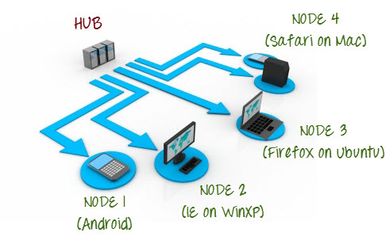
SELENIUM GRID

Slide 28
SELENIUM SERVER LAUNCH
role
node or hub
hub
hub for node (http://localhost:4444/grid/register)
port
4444 by default for hub, 5555 by default for node
browser
browserName=firefox, version=21.0, maxInstances=7, platform=WINDOWS
maxSession
number of parallel tests on node (5 by default)
nodeTimeout
30 s by default, 0 – disable option

Slide 29
CAPABILITIES
BROWSER_NAME – The browser name. Common browser names are defined in the Browser enum.
ELEMENT_SCROLL_BEHAVIOR – Defines how elements should be scrolled into the viewport for interaction. This capability will be set to zero (0) if elements are aligned with the top of the viewport, or one (1) if aligned with the bottom. The default behavior is to align with the top of the viewport.
HANDLES_ALERTS – Whether the driver is capable of handling modal alerts (e.g. alert, confirm, prompt). To define how a driver should handle alerts, use #UNEXPECTED_ALERT_BEHAVIOR.
LOGGING_PREFS - Key for the logging driver logging preferences.
NATIVE_EVENTS - Whether this session generates native events when simulating user input.
PLATFORM - Describes the platform the browser is running on. Will be one of ANDROID, IOS, LINUX, MAC, UNIX, or WINDOWS. When requesting a session, ANY may be used to indicate no platform preference (this is semantically equivalent to omitting the platform capability).
PROXY - Describes the proxy configuration to use for a new WebDriver session.
SUPPORTS_APPLICATION_CACHE - Whether the driver supports manipulating the app cache.
SUPPORTS_CSS_SELECTORS - Whether the driver supports locating elements with CSS selectors.
SUPPORTS_JAVASCRIPT - Whether the browser supports JavaScript.
TAKES_SCREENSHOT - Whether the driver supports taking screenshots.
UNEXPECTED_ALERT_BEHAVIOR Defines how the driver should handle unexpected alerts. The value should be one of "accept", "dismiss", or "ignore".
VERSION - Defines the browser version.
Notes:
https://github.com/SeleniumHQ/selenium/wiki/DesiredCapabilities

Slide 30

SELENIUM GRID SERVER LAUNCH
How to get started with Selenium Grid:
Download Selenium Standalone Server from the official download page. http://www.seleniumhq.org/download/
Start hub instance (via batch file or pure command-line).
java -jar selenium-server-standalone-2.52.0.jar -role hub
Start node instance (via batch file or pure command-line)
java -jar selenium-server-standalone-2.52.0.jar -role node -hub http://localhost:4444/grid/register

Slide 31
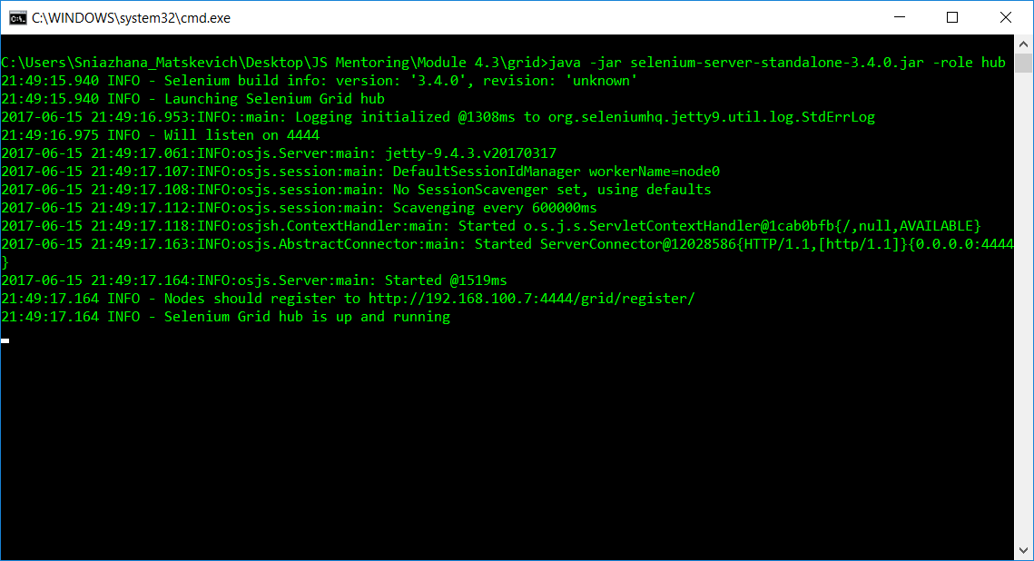
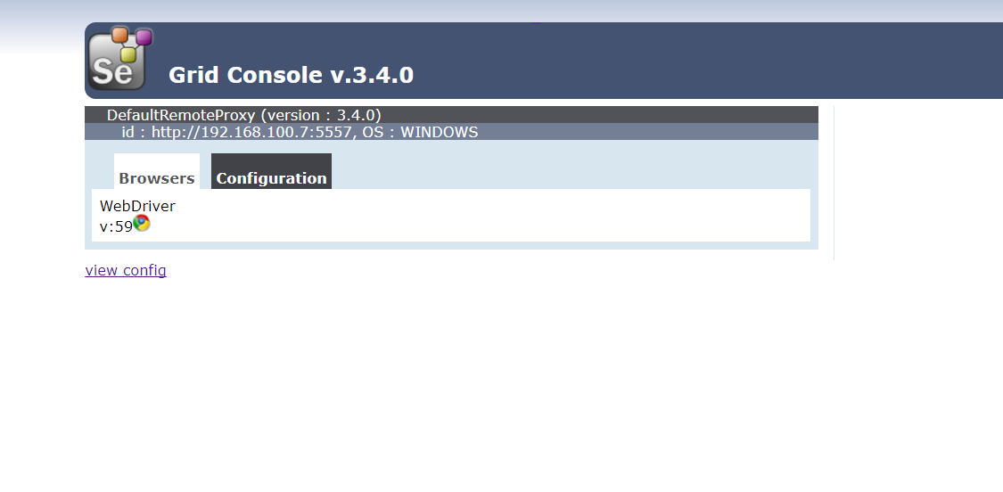
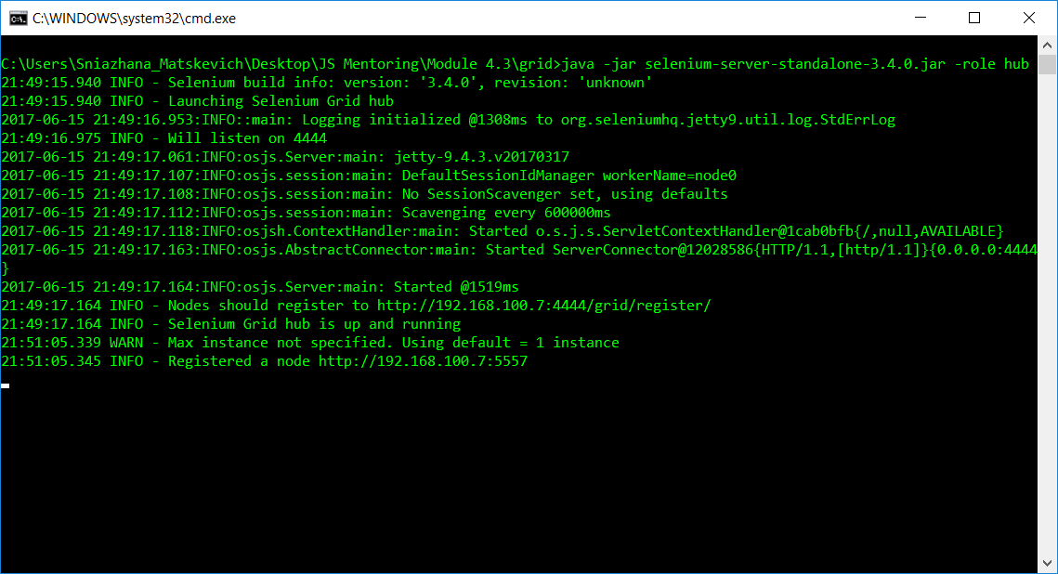
SELENIUM GRID SERVER LAUNCH
How to get started with Selenium Grid:
Check the grid state via OS console output and grid console http://localhost:4444/grid/console .

Slide 32
SELENIUM GRID SERVER LAUNCH
How to get started with Selenium Grid:
Add code snippet to your project for instantiating the WebDriver.
var webDriver = require('selenium-webdriver'); var driver = new webDriver.Builder() .usingServer('http://localhost:4444/wd/hub') .withCapabilities(webDriver.Capabilities.chrome()) .build();

Slide 33
Thanks for attention.
Questions?

